Slide 1
Model-based Testing
Xiao-Xin Li
Zhejiang University of Technology

Slide 2
Why should we use models at all?
In software testing, a model is a simpler way to describe the program under test.
A model preserves some of the original attributes of the system under test. Thus, it can be used to analyse and test the system.
A model gives us a structured way to understand how the program operates (or should operate).
Model-based testing makes use of models of the system to derive tests.
In this chapter, we show what a model is (or can be) and go over two models used in software testing: decision tables and state machines.

Slide 3
Introduction to Model-Based Testing
https://youtu.be/5yuFf4-4JnE

Slide 4
Creating Decision Tables
https://youtu.be/1u1qfJ2IrpU

Slide 5
Testing Decision Tables
There are multiple ways to derive tests for a decision table:
All explicit variants: Derive a test case for each column. The number of tests equals the number of columns in the decision table.
All possible variants: Derive a test case for each possible combination of condition values. For NN conditions this leads to 2^{N} test cases. Often, this approach is unrealistic because of the exponential relationship between the number of conditions and the number of test cases.
Every unique outcome / All decisions: One test case for each unique outcome or action. The number of tests depends on the actions in the decision table.
Each condition T/F: Make sure that each condition is true and false at least once in the test suite. This often results in two tests: all conditions true and all conditions false.

Slide 6
Modified Condition / Decision Coverage (MC/DC)
One more way to derive test cases from a decision table is by using the Modified Condition / Decision Coverage (MC/DC). This is a combination of the last two ways of deriving tests demonstrated above.
Each condition is at least once true and once false in the test suite;
Each unique action should be tested at least once;
Each condition should individually determine the action or outcome.

Slide 7
Testing Decisions in Decision Tables
https://youtu.be/TxAFPJx6yKI

Slide 8
Implementing automated test cases for decision tables
See the textbook.

Slide 9
Non-binary choices and final guidelines
See the textbook and Read it by yourself.

Slide 10
State Machines
A state machine is a model that describes the software system by describing its states. A system often has multiple states and various transitions between these states. The state machine model uses these states and transitions to illustrate the system's behavior.

Slide 11
Notations for State Machines in UML
<state>
State
Initial state
Transition
Event
<Event>

Slide 12
The states in a state machine model describe where a program is in its execution.
The initial state is the state that the system starts in. From that state the system can transition to other states.
Transitions are actions that take the system from one state to another. We can use as many states as we need to describe the system's behavior well.
Each transition is paired with an event. This event is usually one or two words that describe what has to happen to make the transition.

Slide 13
Conditional Transitions
Sometimes an event can lead to multiple states, depending on a certain condition. To model this in the state machines, we use conditional transitions. These transitions are only performed if the event happens and if the condition is true.
The conditions often depend on a certain value being used in the state machine. To modify these values when a transition is taken in the state machine, we use actions. Actions are associated with a transition and are performed when the system uses that transition to go into another state.

Slide 14
Notations for Conditions and Actions
<Event>
[<Condition>]
Conditional transition:
Action
<Event>
/<Action>

Slide 15
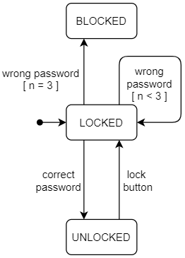
An Example for Conditional Transitions
When a user types the wrong password four times in a row, the phone becomes blocked. We use n in the model to represent the number of failed attempts.
We need to use the conditional transitions to model this behavior.

Slide 16
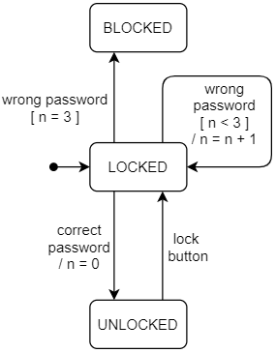
n never changes. This means that the phone will never go to its BLOCKED state, as that requires n to be equal to 3.
We can add actions to the state machine to make n change correctly.
These added actions are to set n to n +1 when an incorrect password is given and to 0 when a correct password is given.

Slide 17
Testing with State Machines
First of all, we look at what might be implemented incorrectly.
An obvious potential error is a transition to the wrong state. So we want the tests to catch such errors.
Additionally, the conditions in conditional transitions and the actions in transition can be wrong.
Finally, the behavior of a state should stay the same at all times. This means that moving from and to a state should not change the behavior of that state.

Slide 18
Test Coverages for State Machines
For state machines, we have a couple of test coverages.
State coverage: each state has to be reached at least once
Transition coverage: each transition has to be exercised at least once
Paths: not exactly a way of describing test coverage, but we use paths to derive test cases
See: https://gitmind.cn/app/doc/d1f1647493

Slide 20
Sneak Paths and Transition Tables
A sneak path is a path in the state machine that should not exist.
A transition table is a table containing each transition that is in the state machine. The transition is given by the state it is going out of, the event that triggers the transition, and the state the transition goes to. A transition table can be constructed as follows:
List all the state machine's states along the rows;
List all events along the columns;
For each transition in the state machine note its destination state in the correct cell of the transition table.

Slide 21
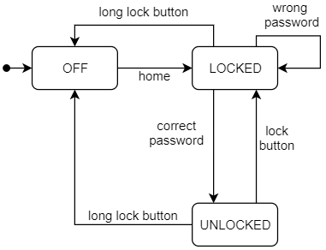
An Example: Construct Transition Tables
Events STATES | home | wrong password | correct password | lock button | long lock button
OFF | LOCKED
LOCKED |  | LOCKED | UNLOCKED |  | OFF
UNLOCKED |  |  |  | LOCKED | OFF

Slide 22
Intended Behavior for Empty Cells
When we have the transition table, we have to decide the intended behavior for the empty cells.
The default is to ignore the event and stay in the same state.
In some cases, one might want the system to throw an exception

Slide 23
Derive Tests for Sneak Paths
To test for all possible sneak paths, we create a test case for each empty cell in the transition table. The number of ‘sneak path tests’ is equal to the number of empty cells in the transition table.
First of all, the test will bring the system to the state corresponding to the empty cell's row (you can use the transition tree to find a suitable path).
Then the test triggers the event corresponding to the empty cell's column.
Finally, the test asserts that the system is in the same state as before triggering the event.

Slide 24
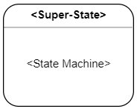
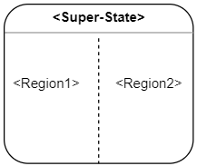
Super States and Regions
Super state: A super state is a state that consists of a state machine. Basically, we wrap a state machine in a super-state which is used as a state in another state machine.
Regions: In some cases, it may be useful to allow the system to be in multiple states at once. This is achieved with regions.

Slide 25
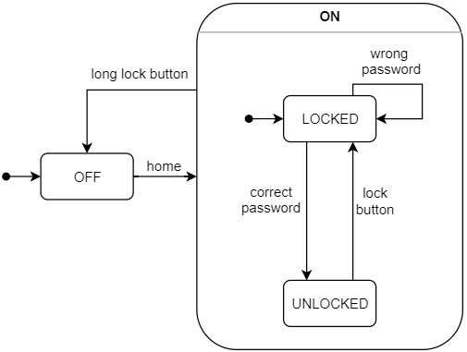
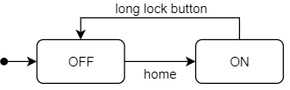
An Example for Super State
We can use a super state even in the small example of a phone's state machine. The two states LOCKED and UNLOCKED both represent the system in some sort of ON state. We can use this to create a super state called ON.
We can also simplify the state machine by collapsing the super state.

Slide 26
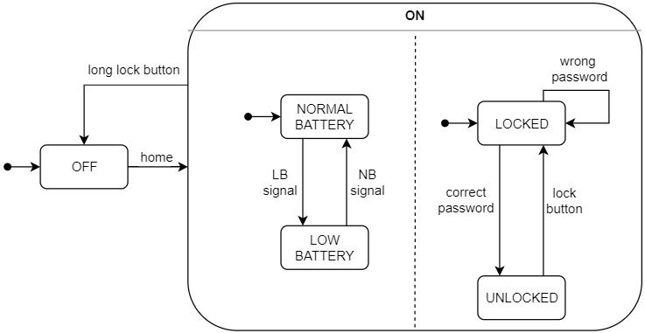
An Example for Regions
When the phone is on, it drains the battery. The system keeps track of the level of the battery. Let's assume that our phone has two battery levels: low and normal.
The draining of the battery and the transitions between the states of the battery run in parallel to the phone being locked or unlocked. With parallel behaviour like this, we can use the regions in the state machine model, which looks like the following, with the new battery states and the regions:

Slide 27
Implementing State-based Testing in Practice
States are very common in programming. Most classes in Object-Oriented-Programming correspond to their own small state machine. In these classes, we distinguish two types of methods: inspection and trigger methods.
An inspection method only provides information about an object's state. This information consists of the values or fields of an object. The inspection methods only provide information. They do not change the state (or values) of an object.
Trigger methods bring the class into a new state. This can be done by changing some of the class's values. These trigger methods correspond to the events on the transitions in the state machine.
In a test, we want to bring the class to different states and assert that after each transition, the class is in the expected state. In other words, a test scenario is basically a series of calls on the class's trigger methods. Between these calls, we can call the inspection methods to check the state.

Slide 28
When a state machine corresponds to a single class, we can easily use the methods described above to test the state machine. However, sometimes the state machine spans over multiple classes. In that case, you might not be able to identify the inspection and trigger methods easily. In this scenario, the state machines can even correspond to end-to-end / system testing. Here, the flow of the entire system is under test, from input to output.

Slide 29
The system under test does not always provide a programming interface (API) to inspect the state or trigger the event for the transitions. A common example of such a system is a web application.
In the end, the web application works through a browser. To access the state or to trigger the transitions you would then need to use a dedicated tool to control the browser. Using such a dedicated tool directly is not ideal, as you would have to specify each individual click on the web page to trigger events.
What we need is an abstraction layer on top of the system being tested. This abstraction can be a Java class, with the methods that we need to be able to test the system as its state machine. In this way, the abstraction layer will contain the inspection method to check the state and the trigger methods to perform the transitions.
With this small abstraction layer, we can formulate the tests clearly. An example of such an abstraction layer is discussed in the chapter on web testing.

